Slide 1

PROJECT TITLE
PRODUCT DATA MANAGEMENT OF ENGINE OIL DRAINER USING TEAMCENTER
Roll No/Student Name
20BME002 / NAVANEETHAN S
20BME012 / JESMOND FRANC R
Guide Name
Dr. S. Madhusudhanan
AP/(SG)

Slide 2
CONTENTS
OBJECTIVE
METHODOLOGY
LITERATURE REVIEW
INTRODUCTION
COMPONENTS & SPECIFICATION
WORKING OPERATION
MODELLING USING CREO
REFERENCES

Slide 3
OBJECTIVE
Product: Oil Changing Machine
PLM Software: Teamcenter
Overview of the Product: It is used to change the used oil of the engine in two-wheelers, which makes the process easier and reduces the time and the work of Manpower.
This machine will avoid the harmfulness caused by heated engine oil such as oil spillage on hands while removing nuts, thus enhancing workers' safety.
Teamcenter is used to manage the Product Lifecycle by working on different modules.

Slide 4
METHODOLOGY
Title Selection
Cost Analysis
Component Purchasing
Material Selection

Slide 5
Designing
Integrating with Teamcenter
Manufacturing
Assembly
Testing

Slide 6
LITERATURE REVIEW
S.NO​ | AUTHOR​ | PAPER JOURNAL​ | DESCRIPTION​ | LINKS​
1.​ | Shrikant Baliram Pokale,​ Sawan Sakharam Borul,​ M.K.Rodge​ | Client Side Customization for Checking User Rights in Teamcenter-PLM​ | Talks about client-side customization and allotting user rights for user safety.​ | https://citeseerx.ist.psu.edu/document?repid=rep1&type=pdf&doi=8e1cf3a0b9a23603177e2947a274fd228b7c4cf6​
2.​ | Jaykumar Yoga Mule​ | PLM based Customization for Extraction of NX Assembly from Team center to Local Drive​ | Talks about extraction of NX assembly from Teamcenter to Local Drive.​ | https://research.ijais.org/volume2/number6/ijais12-450381.pdf​ ​

Slide 7
INTRODUCTION
The machine is introduced to reduce manpower and to produce the work with high efficiency. The machine works with two vacuum pumps for the suction and delivery of oil. It is used only for two-wheelers.
Application:
It is used in two-wheeler service centers.
It is used in petroleum stations.
Advantages:
Efficiency is high
Provides less time
Easily movable to other workstations
Reduces risk of worker

Slide 8
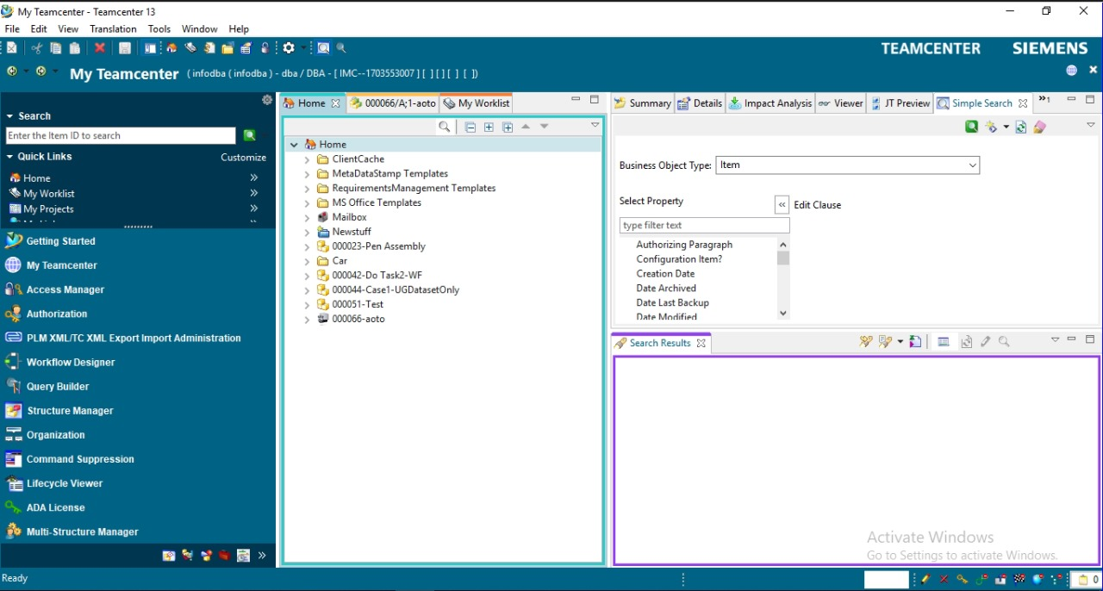
PLM (Product Lifecycle Management) is the process of managing a product as it moves through the four stages of the product lifecycle (introduction, growth, maturity, and decline).​
Teamcenter provides documentation tools to help your teams create specifications, analysis reports 2D/3D illustrations, spreadsheets, test results, and technical publications.

Slide 9
WORKING OPERATION
The vacuum pump is attached on the alternate side of the Suction pump and the hoses are connected on the side of the right. When we turn on the vacuum pump after setting up the Engine through the bottom attachment. It will hold the oil with pressure so that oil leakage will be avoided. Once the vacuum is created, the suction process occurs through a suction pump on the top attachment. When we turn on the suction pump it absorbs the oil with 99% Efficiency and stores it in the Microwave Plastic Container, Then the used oil can be taken through the valve connected to the hose on the other side.

Slide 10
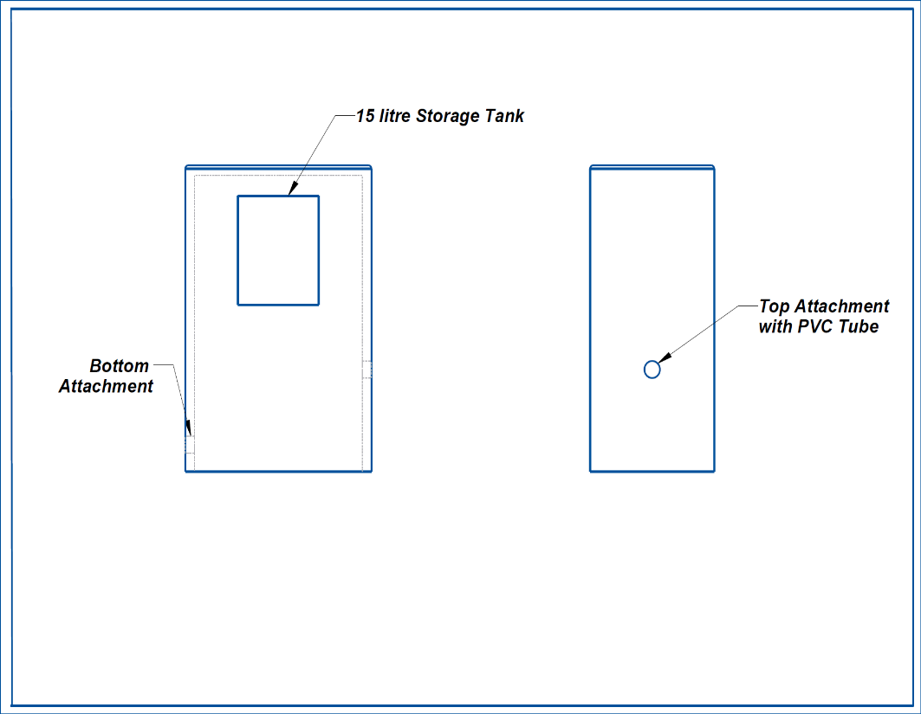
MODELLING USING NX-CAD
GENERAL LAYOUT :

Slide 11
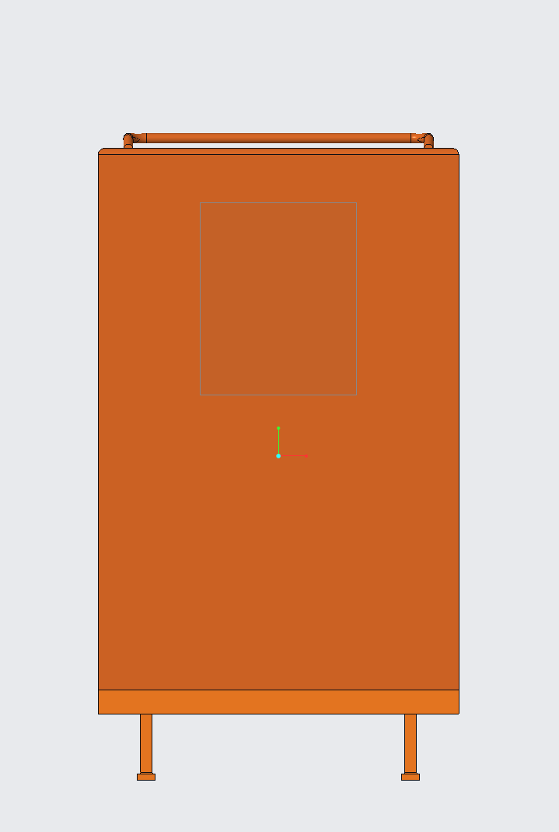
MODELLED PART:

Slide 12
REFERENCES
Mr. Narangale Digvijay Dhondiram “Customization of BMIDE at Customer End as per Business Requirement” Journal on IISRD (International Journal of Trend in Scientific Research and Development),2021, Vol 5(3), pp. 44-49​
https://www.slideshare.net/YogeshIJTSRD/customization-of-bmide-at-customer-end-as-per-business-requirement​
2. Siemens Xccelerator Academy ​
https://training.plm.automation.siemens.com/index.cfm

Slide 13


